Slide 1
Modularity in
Abstract Software Design:
A Theory and Applications
Dissertation Proposal on
Yuanfang Cai
Dept. of Computer Science
University of Virginia

Slide 2
Motivation
Software Development: A Complex Decision-making Process
Difficult Decision Problems in Practice:
  Design decisions to minimize long term cost of change
  Refactoring existing system vs. feature delivery
  Best decision-making order to minimize the need for rework
  All the possible ways to accommodate a given change in design.
  Best design minimizes the cost of change over time given anticipated changes

Slide 3
Motivation
Design Coupling Structure is Complex
No Theoretical Framework to:
  Represent design and design spaces in abstract but precise way
  Formulate decision problems precisely
  Solve decision problems analytically

Slide 4
Proposal
A Theory of Modularity
  Abstract design representation
  A theory of coupling
  Generalized modularization reasoning
An Analytical Framework and Tool
  Formalized decision problems
  Formalized solutions
  Automated analysis

Slide 5
Solution Outline
Key Theoretical Questions Underneath:
  What is the nature of coupling in design?
  What is the nature of a design space?
  What is the nature of modularity in design?
Two Level Contribution
  Theoretical
    Potential to unify disparate modularization methods
  Practical
    Potential to help with decision-making in practice.

Slide 6
Solution Framework:
Represent software design with Constraint Networks (CN)
Model software design space with Design Automaton (DA)
Formalize pair-wise dependence and derive design coupling relations
Formalize methods and analysis techniques

Slide 7
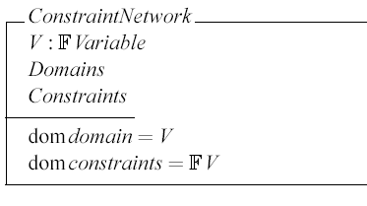

Finite Domain Constraint Networks
Variables -- dimensions to make decisions
Values -- design decisions
Constraints -- relation among decisions
One Consistent Assignment -- a Design
All Consistent Assignments -- a Design Space

Slide 8
Represent Software Design with CN
Variables
  V = {signature, implementation}
Domain
    D = {(signature, sig_1), (signature, unknown),
    (implementation, impl_1), (implementation, unknown)}
Constraints
implementation = impl_1 => signature = sig_1
A design
  {(signature, sig_1), (implementation,impl_1)}
A design space
    {(signature, sig_1), (implementation,impl_1)}
    {(signature, sig_1), (implementation, unknown)}
    {(signature, unknown), (implementation, unknown)}

Slide 9
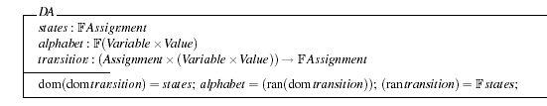
Software Design Automaton (DA)
Design Automaton
  A state: a design
  Alphabet: decision changes, variable-value binding pair
  Transition function: maps a design to another

Slide 10

Software Design Automaton (DA)
Compute DA from CN
  Represent CN’s using constraint languages
  Solve CN’s into design spaces
  Generate Design Automata

Slide 11

Dependence and Coupling Relation
Pair-wise Dependence
  -- Two design variables are defined to be pair-wise dependent if, for some design, there is some change to the first for which the second is involved in some minimal perturbation of the first.
Design Coupling Relation of a CN
  -- The dependence relation over its variables.
Complexity: NP Complete

Slide 12
Dependence and Coupling Relation
Asymmetric Dependence: Design Rule
  Implementation can not influence signature
signature = sig_1
implementation = unknown
signature = sig_1
implementation = impl_1
implementation = unknown
1
implementation = impl_1
2
implementation = impl_1
signature = sig_1
signature = unknown
signature = unknown
3
signature = unknown
implementation = unknown

Slide 13


Dependence and Coupling Relation
Formal Definitions
Asymmetric Coupling Relation

Slide 14
Framework Applications
Account for Modularization Uniformly
  Information Hiding
  Object-Oriented
  Aspect-Oriented
Help with Practical Decision Questions
  Design structure matrices: linking abstract design to existing theory and techniques
    Design rule theory [Baldwin01]
    Task scheduling, e.g. DeMaid
    Cyclic dependence detection
  Precise impact analysis
  Bridge to economic analysis
  …

Slide 15
Early Evaluation
Test case: Parnas’s KWIC Example
  Representing the two KWIC designs as constraint networks using Alloy
  Derive DA and coupling relations
  Represent with DSM
Two Level Evaluation:
  Is the framework expressive enough to:
    Represent design spaces and their coupling structures?
    Decisions from different levels, from environment to design?
    Modularity in terms of information hiding?
  Does the framework help to answer:
    Which design is better?
    What are the possible ways to accommodate a change in environment or design?
    Are the DSM’s generated accurate?

Slide 16
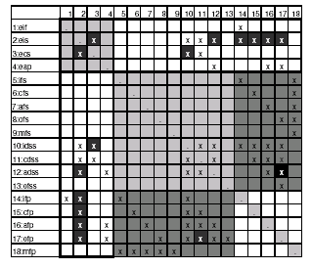
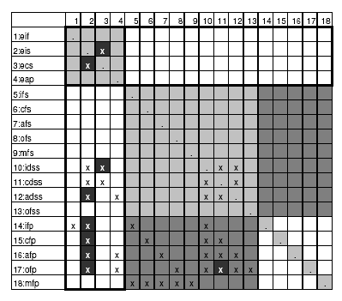
Early Evaluation
KWIC Sequential Design
Environment Variables
Design Rules

Slide 17
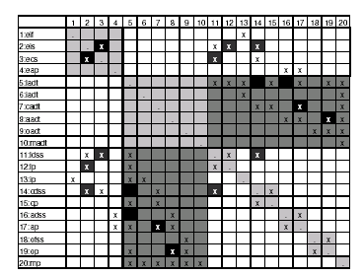
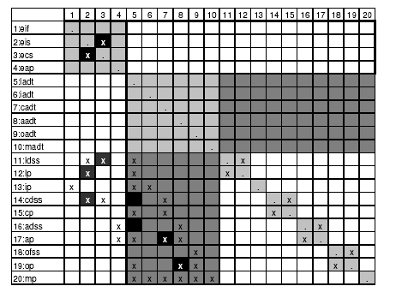
Early Evaluation
KWIC Information Hiding Design
Environment Variables
Design Rules

Slide 18
Early Evidence
Is the framework general enough to account for
  Decisions from different levels, from environment to design?
    Both environment conditions and design decisions are modeled
  Modularity in terms of information hiding?
Does the framework help to answer:
  Which design is better?
    Information hiding is better modularized, consistent to Parnas’s comparison
  What are all the possible ways to accommodate a change in environment or design?
  Are the DSM’s generated accurate?
    Missing ripple effects are found
Performance

Slide 19
Early Evidence
Design Rule, Information Hiding and Modularity
  Load-bearing walls of an information hiding design (the design rules) should be invariant with respect to changes in the environment
  Environment changes should be accommodated by changes to hidden (subordinate) design variables.

Slide 20
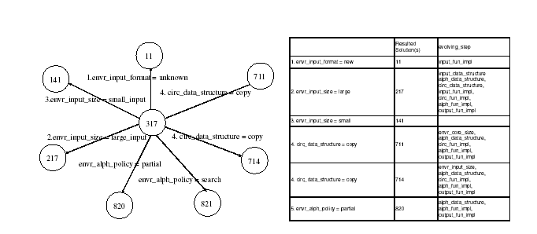
Early Evidence
KWIC Sequential Design

Slide 21
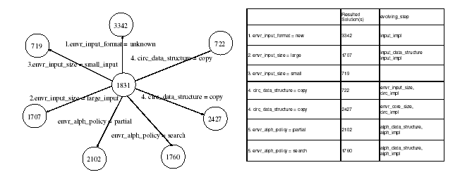
Early Evidence
KWIC Information Hiding Design

Slide 22
Current Status on Performance
Performance and scalability
  Sequential Design with 18 Variables, 12018 Solutions
    1 hour (Alloy) + 11minutes (MCS) = 71 minutes
  Information Hiding Design with 20 Variables, 34907 Solutions
    3 hours (Alloy) + 2 hours 13 minutes (MCS) = 313 minutes

Slide 23
What has been done
Formalized mapping from a CN to a DA
Formalized mapping from a DA to a coupling relation
A tool prototype for:
  Incrementally build constraint networks
  Feed them into an underlying constraint solver
  Automate DA generation
  Automate DSM generation
Early evaluation using KWIC

Slide 24
What Remains
Fully formulate key decision problems and the associated analysis methods -- March, 2005
Automate these analyses by the tool -- May, 2005
Evaluation by more realistic case studies -- July, 2005
Finish my dissertation:
  Optimistically: September, 2005
  Latest: Spring 2006

Slide 25
Methods and Analysis to be Formulated
Impact Analysis
Task Scheduling
Cyclic Dependence Detection
Coordination Overhead Estimation
Evolution Cost Estimation
Net Option Value Computation

Slide 26
Impact Analysis:
Given a current design, what if one or more decisions are changed? What should the new design (s) look like?
Input:
  A abstract logical design representation – a constraint network
  An initial design – an assignment
  A sequence of changing decisions -- a sequence of variable-value binding pairs.
Output:
  A set of evolution paths accommodating the specified decision changes,
  A set of new designs the original one could reach after the changes
Solution:
  find paths from the DA that start from the initial design and go along the edges labeled with specified changes.
Formally:

Slide 27
Additional Experiments
General enough to unify the apparently disparate modularization methods?
  Aspect-oriented experiments
  Design pattern experiments
Has potential as a foundation for methods of decision analysis useful in practice?
  Product line experiments

Slide 28
AO Experiments
Canonical figure example[KICZALES97]
  Can this method model cross-cutting concerns?
  Does the coupling structure derived capture modularity in AO?
More realistic web application [LOPES04],
  Is it possible to model realistic design?
  Are the DSM’s generated consistent? More accurate?
  Does this modeling reveal the same insights?

Slide 29
OO Experiments—Design Patterns
Model different patterns uniformly[GAMMAS00]
  Can this framework capture the interdependent design decisions embedded in different patterns?
  Do the DA’s generated capture the idea that each pattern is for a kind of evolution possibility?
Model the maze game example [GAMMAS00]
  Does this method reveal the essence of the different ways the maze game can be implemented?
  Does the modeling method capture the idea that each pattern for the maze game is due to a hypothesized environment change?
  Is our analysis consistent with that of the authors?

Slide 30
Realistic Experiments—Product Line
Seeking a canonical product line example
  Avaya
  CMU Software Engineering Institute (SEI)
Feasibility
Utility
Scalability:
  Transformations: Abstraction, decomposition, etc.
  How hard is it to do these transformations?
  Do these transformations improve the performance?
  Can we still get useful and insightful results?

Slide 31
Future Work
Infinite domain constraints
Tractability
Quantification notation
Dynamic design spaces
Formal theory of value of modularity

Slide 32
Questions? Comments?

Slide 33
Software Design Automaton (DA)
Represent CN’s using constraint languages: Alloy
sig sig_domain {}
static part sig_1, unknown_sig extends sig_type {}
sig impl_domain {}
static part impl_1, unknown_impl extends impl_type {}
sig design {
signature: sig_domain,
implementation: impl_domain
}{
implementation = impl_1 => signature = sig_1
}

Slide 34
Software Design Automaton (DA)
Solve CN’s into design spaces
1.signature = sig_1
implementation = impl_1
2. signature = sig_1
implementation = unknown
3. signature = unknown
implementation = unknown

Slide 35
Software Design Automaton (DA)
Generate Design Automaton
signature = sig_1
signature = sig_1
implementation = unknown
implementation = unknown
implementation = impl_1
1
implementation = impl_1
2
implementation = impl_1
signature = sig_1
signature = unknown
signature = unknown
3
signature = unknown
implementation = unknown

Slide 36
Software Design Automaton (DA)
DA is nondeterministic
V = v2
V = v2
V = v1
A = a2
A = a1
B = b1
B = b1
V = v2
V = v2
A = a1
B = b2

Slide 37
Software Design Automaton (DA)
DA is minimal
signature = sig_1
signature = sig_1
implementation = unknown
implementation = unknown
implementation = impl_1
1
2
implementation = unknown
3
signature = unknown
implementation = unknown

Slide 38
Dependence and Coupling Relation
What is dependence
  Minimal Change Set: {a}, {b} and {c}
  Minimal Change Group: mcsgroup(cn, 1, v, v2) = { {a}, {b}}
  Minimal Change Sets: mcssets(cn, v) = { {a}, {b}, {c}}
V = v2
2
V = v2
A = a2
B = b1
V = v1
C = c1
A = a1
B = b1
V = v2
1
C = c1
V = v2
A = a1
B = b2
3
C = c1
V = v3
V = v3
A = a1
4
B = b2
C = c1

